Slide 1
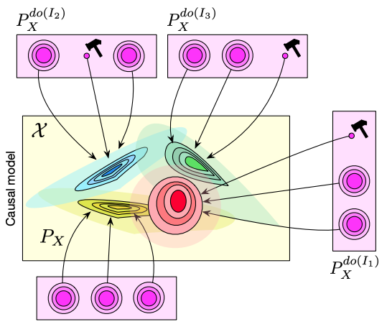

Causal Machine Learning
张江
北京师范大学系统科学学院教授
集智俱乐部、集智学园创始人
集智研究中心理事长
更多“人工智能 & 复杂系统”的知识，请关注官网：campus.swarma.org
Notes:
封面

Slide 2
Outline
Causal Machine Learning: Background and Principles
Causal Discovery
Causal Representation Learning
Causal Emergence and Neural Information Squeezer
更多“人工智能 & 复杂系统”的知识，请关注官网：campus.swarma.org

Slide 3
Hierarchy of Causality
Judea Pearl: The Book of Why

Slide 4
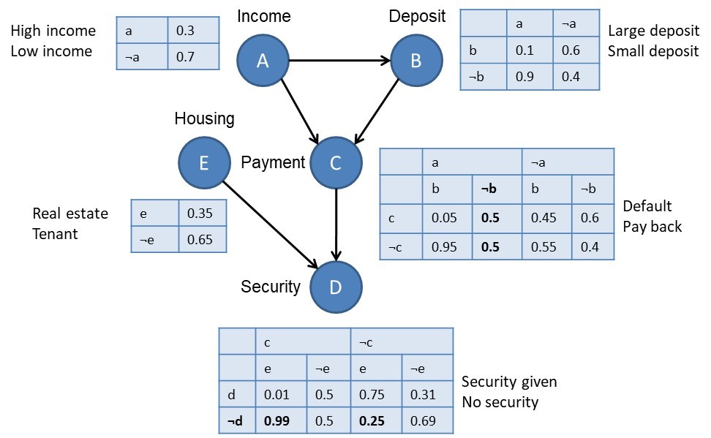
Bayesian Network v.s. Causal Graph
Bayesian Network
Causal Graph
A
B
C
E
D
更多“人工智能 & 复杂系统”的知识，请关注官网：campus.swarma.org

Slide 5
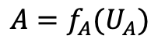


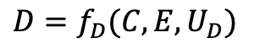


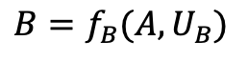
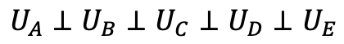
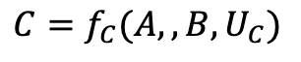

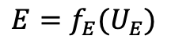
Causal Graph v.s. Structural Causal Model
$$U_{A}$$
$$U_{B}$$
$$A=f_{A}(U_{A})$$
A
B
A
B
$$B=f_{B}(A,U_{B})$$
$$U_{C}$$
$$U_{E}$$
C
C
$$C=f_{C}(A,,B,U_{C})$$
E
E
$$E=f_{E}(U_{E})$$
D
D
$$U_{D}$$
$$U_{A}⊥U_{B}⊥U_{C}⊥U_{D}⊥U_{E}$$
$$D=f_{D}(C,E,U_{D})$$
更多“人工智能 & 复杂系统”的知识，请关注官网：campus.swarma.org

Slide 6
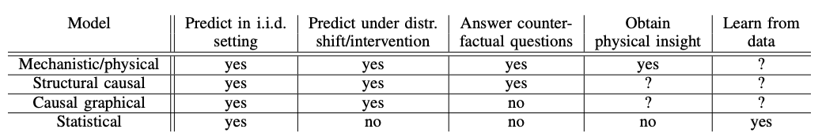
Classification of Models
https://arxiv.org/pdf/2102.11107.pdf

Slide 7
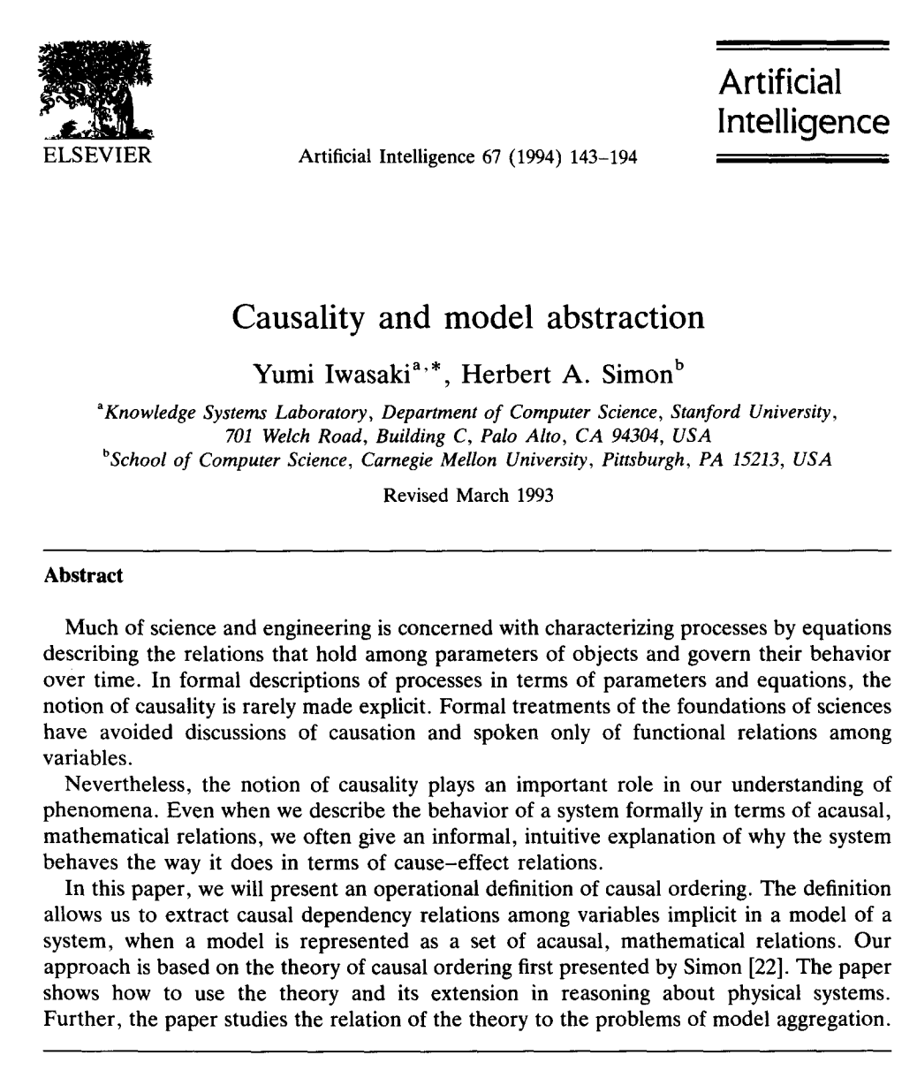
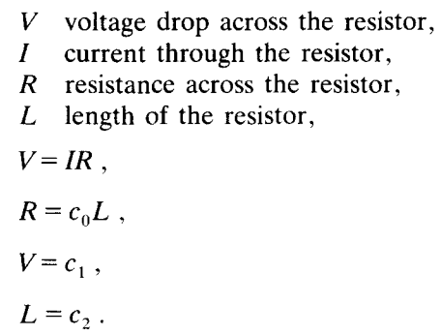
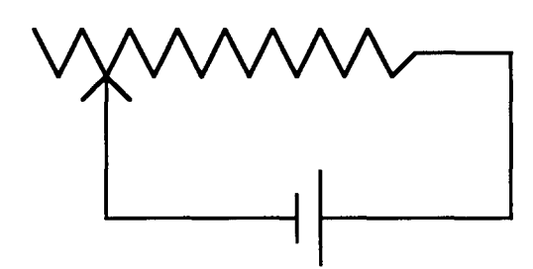
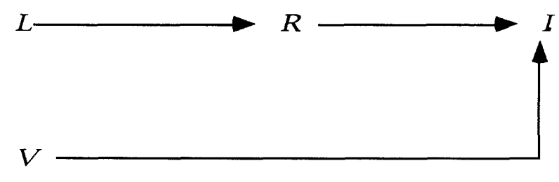
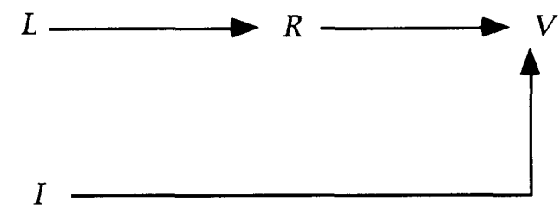
Mechanism and Causality
Yumi Iwasaki, Herbert A. Simon: Causality and model abstraction, Artificial Intelligence, Volume 67, Issue 1,1994, Pages 143-194,

Slide 8
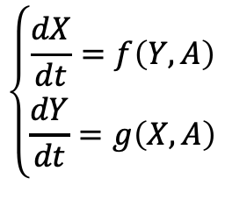
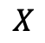
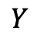
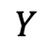
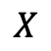
Mechanism and Causality
$$Y$$
$$X$$
$$\left\{\begin{matrix}\frac{dX}{dt}=f\left(Y,A\right) \\ \frac{dY}{dt}=g\left(X,A\right)\end{matrix}\right.$$
$$X$$
$$Y$$
Yumi Iwasaki, Herbert A. Simon: Causality and model abstraction, Artificial Intelligence, Volume 67, Issue 1,1994, Pages 143-194,

Slide 9
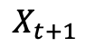
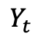
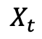
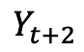
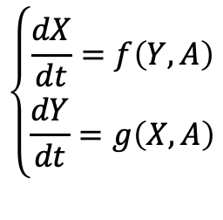
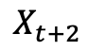
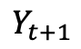
Mechanism and Causality
$$X_{t}$$
$$Y_{t}$$
$$\left\{\begin{matrix}\frac{dX}{dt}=f\left(Y,A\right) \\ \frac{dY}{dt}=g\left(X,A\right)\end{matrix}\right.$$
$$X_{t+1}$$
$$Y_{t+1}$$
$$X_{t+2}$$
$$Y_{t+2}$$
……
……
Yumi Iwasaki, Herbert A. Simon: Causality and model abstraction, Artificial Intelligence, Volume 67, Issue 1,1994, Pages 143-194,

Slide 10
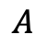
Mechanism and Causality
$$X_{t}$$
$$Y_{t}$$
$$\left\{\begin{matrix}\frac{dX}{dt}=f\left(Y,A\right) \\ \frac{dY}{dt}=g\left(X,A\right)\end{matrix}\right.$$
$$X_{t+1}$$
$$Y_{t+1}$$
$$A$$
$$X_{t+2}$$
$$Y_{t+2}$$
……
……
Yumi Iwasaki, Herbert A. Simon: Causality and model abstraction, Artificial Intelligence, Volume 67, Issue 1,1994, Pages 143-194,

Slide 11
Mechanism and Causality
Mechanism:
Global
Causality:
Local
One Mechanism may correspond to many causal graphs
Parameters are confounders
Reconstructing mechanism is more difficult than causations
Yumi Iwasaki, Herbert A. Simon: Causality and model abstraction, Artificial Intelligence, Volume 67, Issue 1,1994, Pages 143-194,

Slide 12
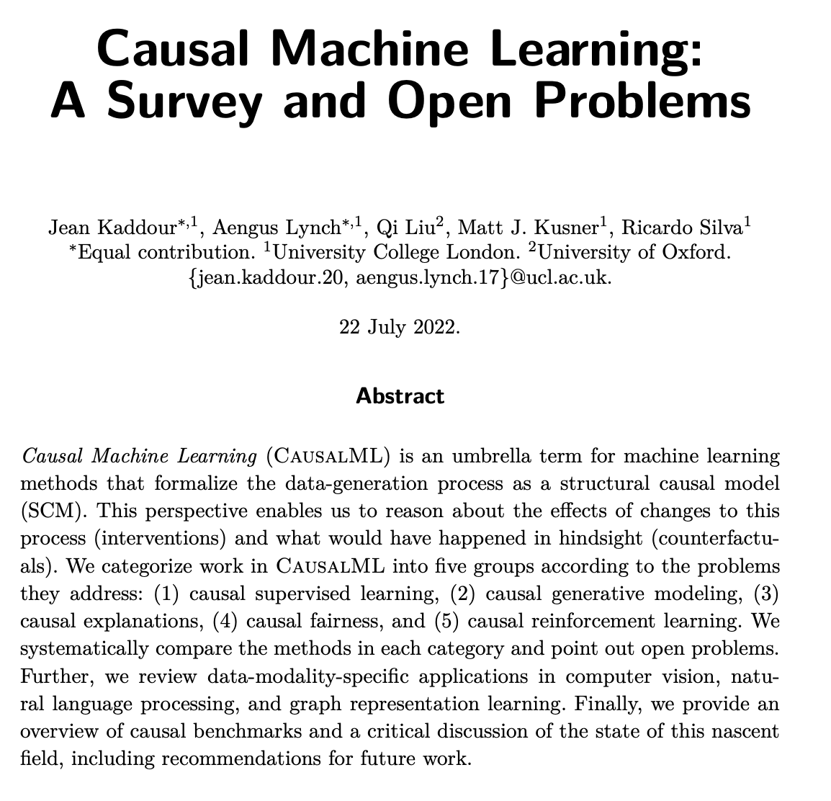
Causal Machine Learning
Causal Machine Learning (CausalML) is an umbrella term for machine learning methods that formalize the data-generation process as a structural causal model (SCM) [Kaddour et.al].
https://arxiv.org/pdf/2206.15475.pdf,

Slide 13
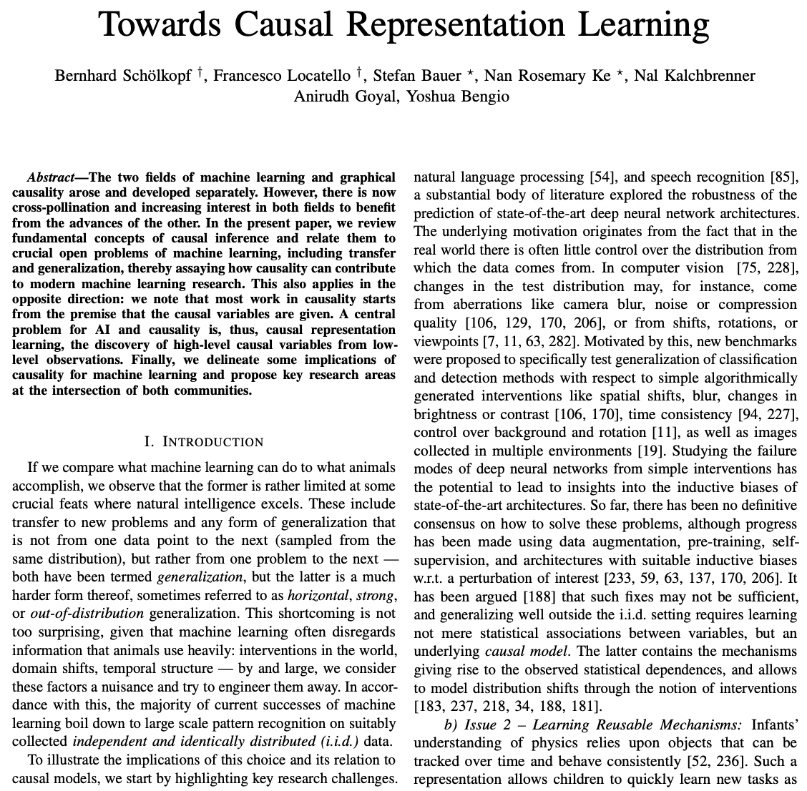
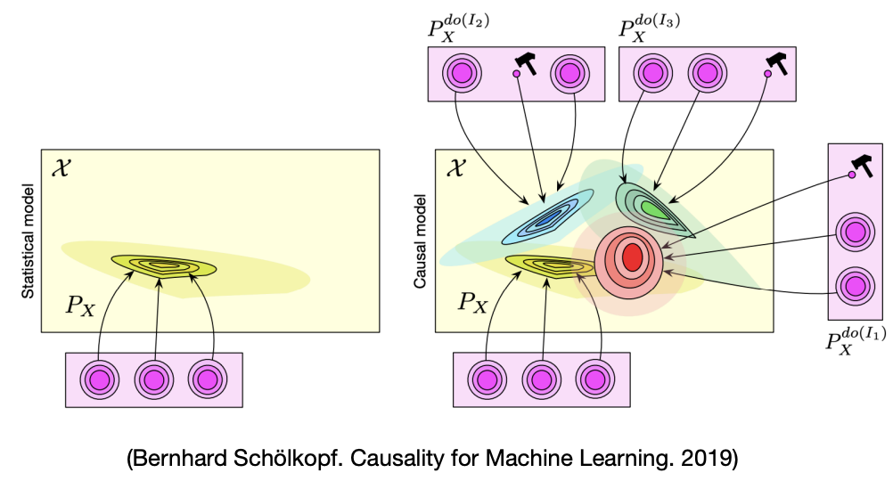
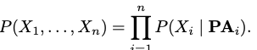
Causal Machine Learning
Difference between statistical (left) and causal models (right) on a given set of three variables. While a statistical model specifies a single probability distribution, a causal model represents a set of distributions, one for each possible intervention
https://arxiv.org/pdf/2102.11107.pdf

Slide 14
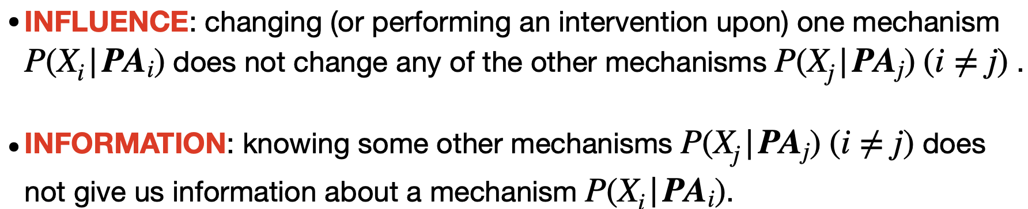
Principle I: Independent Causal Mechanism
Independent Causal Mechanisms (ICM) Principle. The causal generative process of a system’s variables is composed of autonomous modules that do not inform or influence each other.
https://arxiv.org/pdf/2102.11107.pdf
https://pattern.swarma.org/study_group_issue/289
Chaochao Lu, Nov 2023 in Swarma Club

Slide 15
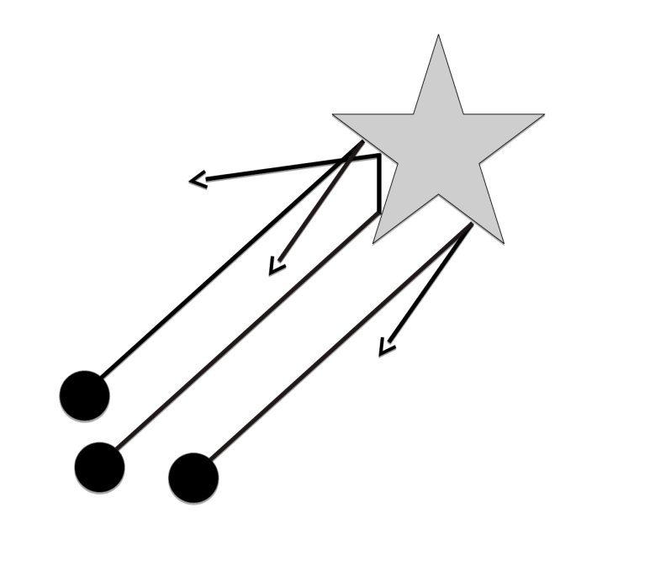
Example - Gedankenexperiment
• incoming beam: “cause”
• scattering at object: “mechanism”
• outgoing beam: “effect”, contains information about the object
Peters et al. Elements of Causal Inference. 2017
https://pattern.swarma.org/study_group_issue/289
Chaochao Lu, Nov 2023 in Swarma Club

Slide 16
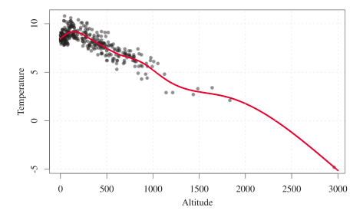
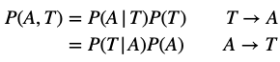
Example
Peters et al. Elements of Causal Inference. 2017
https://pattern.swarma.org/study_group_issue/289
Chaochao Lu, Nov 2023 in Swarma Club

Slide 17
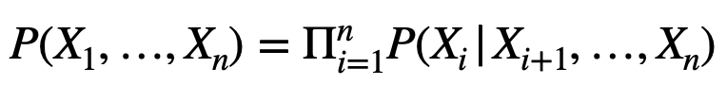
Principle II: Sparse Mechanism Shift
Sparse Mechanism Shift (SMS): Small distribution changes tend to manifest themselves in a sparse or local way in the causal/disentangled factorization (4), i.e., they should usually not affect all factors simultaneously
We view any real-world distribution as a product of causal mechanisms. Therefore, a change in such a distribution will always be due to changes in at least one of those mechanisms.
In contrast, if we consider a non-causal factorisation, e.g., the one below, then many, if not all, terms will be affected simultaneously.
https://arxiv.org/pdf/2102.11107.pdf
https://pattern.swarma.org/study_group_issue/289
Chaochao Lu, Nov 2023 in Swarma Club

Slide 18
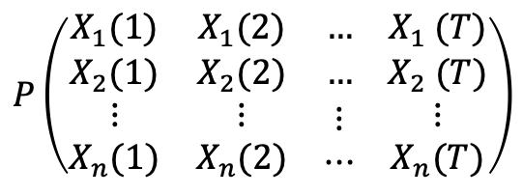
Complex Dynamical Systems
T=2
复杂动力系统的本质就是一个联合概率分布：
$$P\left(\begin{matrix}X_{1}(1) & X_{1}(2) & … \\ X_{2}(1) & X_{2}(2) & … \\ \begin{aligned}⋮ \\ X_{n}(1)\end{aligned} & \begin{aligned}⋮ \\ X_{n}(2)\end{aligned} & \begin{aligned}⋮ \\ ⋯\end{aligned}\end{matrix}\begin{matrix} \\ \\ \begin{aligned} \\ \end{aligned}\end{matrix}\begin{matrix}X_{1} (T) \\ X_{2} (T) \\ \begin{aligned}⋮ \\ X_{n}(T)\end{aligned}\end{matrix}\right)$$
T=1
更多“人工智能 & 复杂系统”的知识，请关注官网：campus.swarma.org

Slide 19
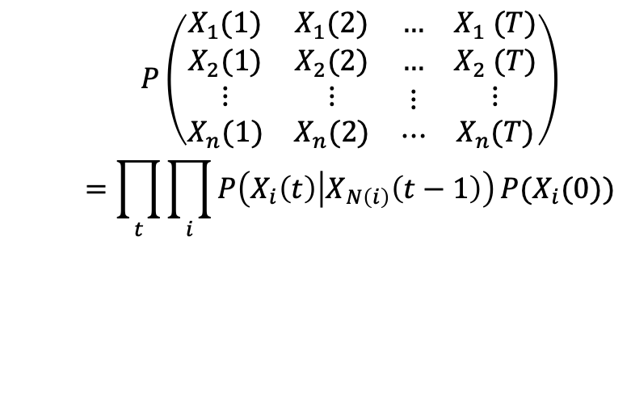
Complex Dynamical Systems
复杂系统建模的本质就是如何分解联合概率分布为一系列因果模块
T=2
$$P\left(\begin{matrix}X_{1}(1) & X_{1}(2) & … \\ X_{2}(1) & X_{2}(2) & … \\ \begin{aligned}⋮ \\ X_{n}(1)\end{aligned} & \begin{aligned}⋮ \\ X_{n}(2)\end{aligned} & \begin{aligned}⋮ \\ ⋯\end{aligned}\end{matrix}\begin{matrix} \\ \\ \begin{aligned} \\ \end{aligned}\end{matrix}\begin{matrix}X_{1} (T) \\ X_{2} (T) \\ \begin{aligned}⋮ \\ X_{n}(T)\end{aligned}\end{matrix}\right)$$
$$=\prod_{t}{\prod_{i}{P\left(X_{i}\left(t\right) | X_{N\left(i\right)}\left(t−1\right)\right)}}P(X_{i}(0))$$
因果联系
T=1
动力学学习
初始条件学习
更多“人工智能 & 复杂系统”的知识，请关注官网：campus.swarma.org

Slide 20
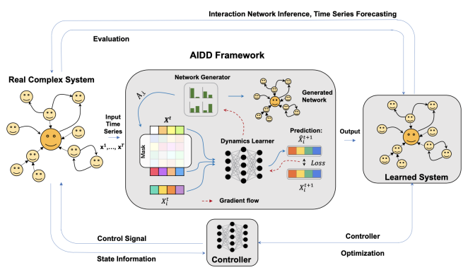
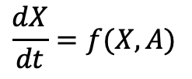
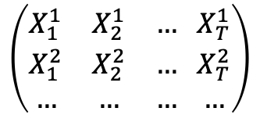
Feasibility and Efficiency?
$$\left(\begin{matrix}X_{1}^{1} & X_{2}^{1} & … \\ X_{1}^{2} & X_{2}^{2} & … \\ … & … & …\end{matrix} \begin{matrix}X_{T}^{1} \\ X_{T}^{2} \\ …\end{matrix}\right)$$
$$\frac{dX}{dt}=f(X,A)$$
Amount of Data
A Large Number of Different Samples of Data
更多“人工智能 & 复杂系统”的知识，请关注官网：campus.swarma.org

Slide 21
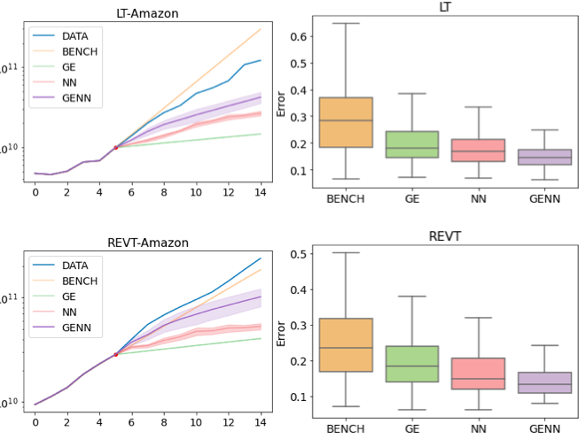
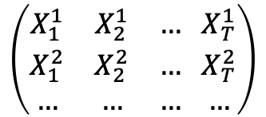
Feasibility and Efficiency?
$$\left(\begin{matrix}X_{1}^{1} & X_{2}^{1} & … \\ X_{1}^{2} & X_{2}^{2} & … \\ … & … & …\end{matrix} \begin{matrix}X_{T}^{1} \\ X_{T}^{2} \\ …\end{matrix}\right)$$
$$\frac{dX}{dt}=f(X,A)$$
Amount of Data
A Large Number of Different Samples of Data
Fails in sSome Real Cases
更多“人工智能 & 复杂系统”的知识，请关注官网：campus.swarma.org

Slide 22
Outline
Causal Machine Learning: Background and Principles
Causal Discovery
Causal Representation Learning
Causal Emergence and Neural Information Squeezer
更多“人工智能 & 复杂系统”的知识，请关注官网：campus.swarma.org

Slide 23
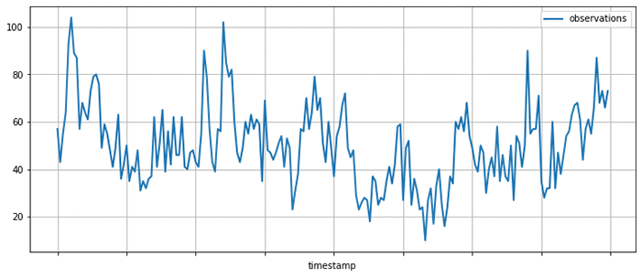
What is Causal Discovery
A
B
Causal Discovery Algorithm
C
E
D
更多“人工智能 & 复杂系统”的知识，请关注官网：campus.swarma.org

Slide 24
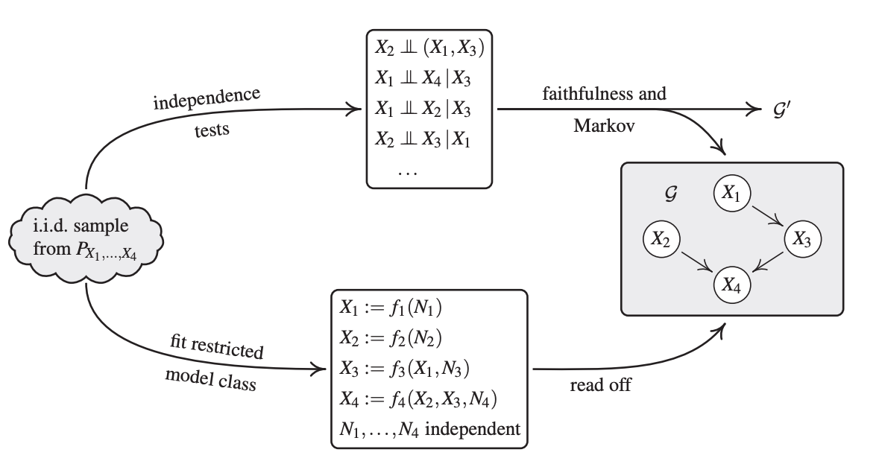
Methods: Independence and Score based
张天健: 因果发现介绍及Tetrad工具包使用教程，集智学园

Slide 25
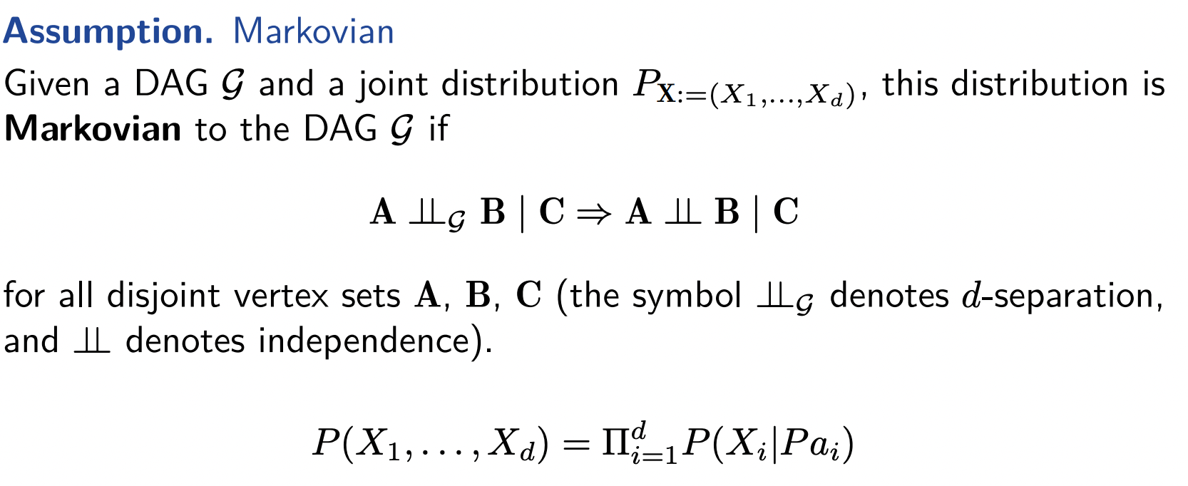
Independence: Markov Assumptions
张天健: 因果发现介绍及Tetrad工具包使用教程，集智学园

Slide 26
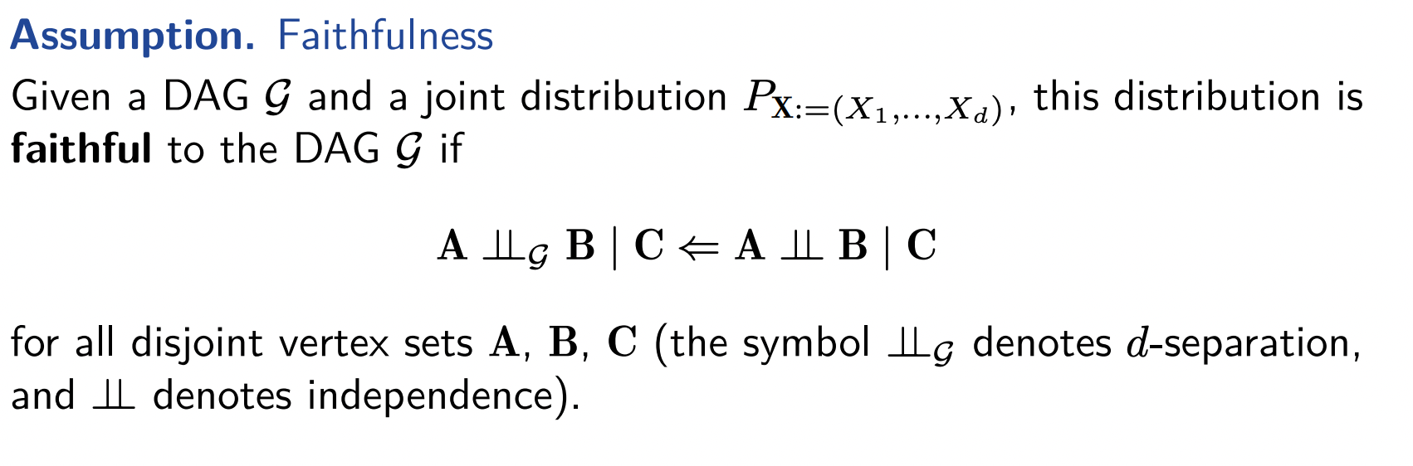
Faithfulness Assumptions
张天健: 因果发现介绍及Tetrad工具包使用教程，集智学园

Slide 27
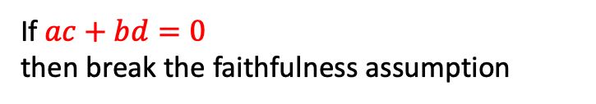
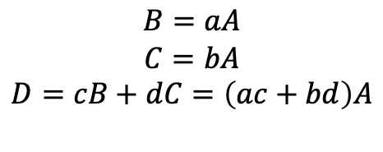
Counter-example
A
a
b
$$B=aA$$
$$C=bA$$
$$D=cB+dC=\left(ac+bd\right)A$$
B
C
c
d
If $ac+bd=0$
then break the faithfulness assumption
D
Brady Neal: Introduction to Causal Inference, https://www.bradyneal.com/causal-inference-course

Slide 28
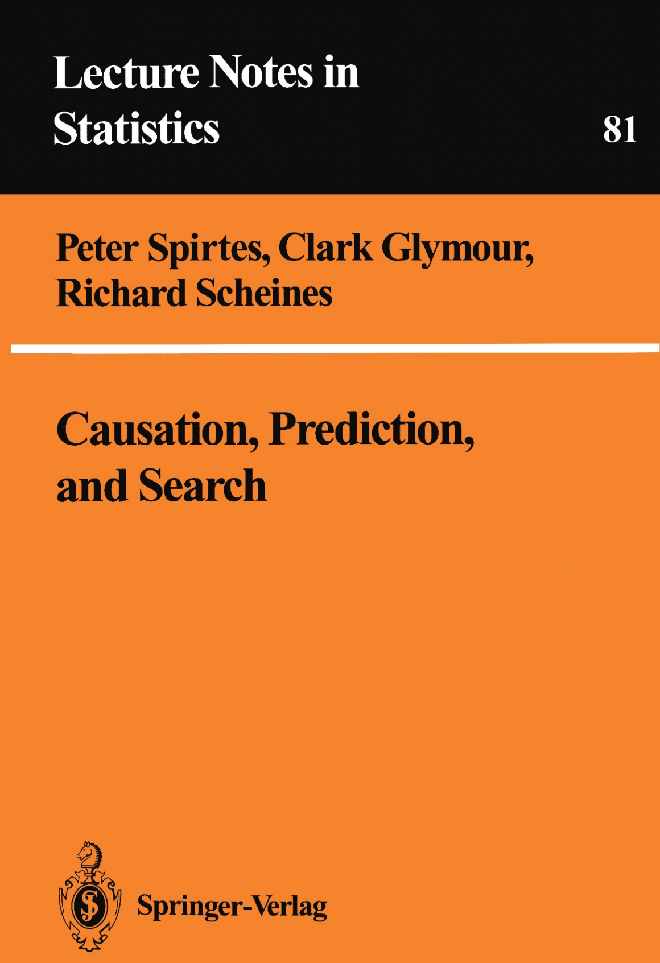

PC algorithm
https://www.jmlr.org/papers/volume8/kalisch07a/kalisch07a.pdf

Slide 29
Real Graph
A
B
PC algorithm
C
Start with complete undirected graph
Three steps:
Identify the skeleton
Identify colliders and orient them
Orient qualifying edges that are incident on colliders
D
E
Complete Graph
A
B
C
D
E
Brady Neal: Introduction to Causal Inference, https://www.bradyneal.com/causal-inference-course

Slide 30



Markov Equivalence
A
C
B
Chain
Chain
Fork
Skeleton:
A
C
B
Brady Neal: Introduction to Causal Inference, https://www.bradyneal.com/causal-inference-course

Slide 31


Markov Equivalence
Collider
Skeleton:
A
C
B
Brady Neal: Introduction to Causal Inference, https://www.bradyneal.com/causal-inference-course

Slide 32

Real Graph
A
B
PC algorithm – step 1
C
Remove edges X-Y where $X⊥Y | Z$ for some (potentially empty) conditioning set Z, starting with the empty conditioning set and increasing the size
D
E
A
B
C
D
E
Brady Neal: Introduction to Causal Inference, https://www.bradyneal.com/causal-inference-course

Slide 33

Real Graph
A
B
PC algorithm – step 1
C
Remove edges X-Y where $X⊥Y | Z$ for some (potentially empty) conditioning set Z, starting with the empty conditioning set and increasing the size
D
E
$X⊥Y |${}
A
B
C
D
E
Brady Neal: Introduction to Causal Inference, https://www.bradyneal.com/causal-inference-course

Slide 34

Real Graph
A
B
PC algorithm – step 1
C
Remove edges X-Y where $X⊥Y | Z$ for some (potentially empty) conditioning set Z, starting with the empty conditioning set and increasing the size
D
E
$X⊥Y |${}
A
B
$$∀\left(X,Y\right): X⊥Y |\{C\}$$
C
D
E
Brady Neal: Introduction to Causal Inference, https://www.bradyneal.com/causal-inference-course

Slide 35

Real Graph
A
B
PC algorithm – step 1
C
Remove edges X-Y where $X⊥Y | Z$ for some (potentially empty) conditioning set Z, starting with the empty conditioning set and increasing the size
D
E
$X⊥Y |${}
A
B
$$∀\left(X,Y\right): X⊥Y |\{C\}$$
C
D
E
Brady Neal: Introduction to Causal Inference, https://www.bradyneal.com/causal-inference-course

Slide 36
Real Graph
A
B
PC algorithm – step 2
C
For any path X-Z-Y:
We discover that there is no edge between X and Y in previous step.
Z was not in the conditioning set that makes X and Y conditionally independent
Then, we have the collider: X→Z← Y
D
E
Skeleton
A
B
C
D
E
Brady Neal: Introduction to Causal Inference, https://www.bradyneal.com/causal-inference-course

Slide 37
Real Graph
A
B
PC algorithm – step 2
C
For any path X-Z-Y:
We discover that there is no edge between X and Y in previous step.
Z was not in the conditioning set that makes X and Y conditionally independent
Then, we have the collider: X→Z← Y
D
E
Skeleton + Collider
A
B
C
D
E
Brady Neal: Introduction to Causal Inference, https://www.bradyneal.com/causal-inference-course

Slide 38
Real Graph
A
B
PC algorithm – step 3
C
Use the fact that we have found all colliders to orient edges
D
E
Skeleton + Collider
A
B
C
D
E
Brady Neal: Introduction to Causal Inference, https://www.bradyneal.com/causal-inference-course

Slide 39
Real Graph
A
B
PC algorithm – step 3
C
Use the fact that we have found all colliders to orient edges:
Any edge Z-Y part of a partially directed path of the form X→Z-Y, where there is no edge connecting X and Y can be oriented as Z→Y or Y→Z according to if V-structure can be avoided
D
E
A
B
C
D
E
Brady Neal: Introduction to Causal Inference, https://www.bradyneal.com/causal-inference-course

Slide 40

PC algorithm
https://www.jmlr.org/papers/volume8/kalisch07a/kalisch07a.pdf

Slide 41
Theorem: Collider and Skeleton
Two graph qualities can be used to distinguished graphs
Collider
Skeleton
Essential graph: skeleton + colliders
Brady Neal: Introduction to Causal Inference, https://www.bradyneal.com/causal-inference-course

Slide 42
PC algorithm
Not Complete
https://www.jmlr.org/papers/volume8/kalisch07a/kalisch07a.pdf

Slide 43


More Causal Discovery Methods
张坤
卡内基梅隆大学哲学系助理教授和机器学习系副教授，研究兴趣是机器学习和人工智能
https://www.frontiersin.org/articles/10.3389/fgene.2019.00524/full

Slide 44
Difference with Granger Causality?
Graph Neural Network
Inferred Network and Dynamics
https://journals.aps.org/pre/abstract/10.1103/PhysRevE.106.034315

Slide 45








Difference?
A
B
$$X_{t}$$
$$Y_{t}$$
Granger Causality
C
=
$$X_{t+1}$$
$$Y_{t+1}$$
$$X$$
$$Y$$
E
D
$$X_{t+2}$$
$$Y_{t+2}$$
更多“人工智能 & 复杂系统”的知识，请关注官网：campus.swarma.org

Slide 46
Outline
Causal Machine Learning: Background and Principles
Causal Discovery
Causal Representation Learning
Causal Emergence and Neural Information Squeezer
更多“人工智能 & 复杂系统”的知识，请关注官网：campus.swarma.org

Slide 47

Causal Features
[Chalupka et al. 2016], https://link.springer.com/article/10.1007/s41237-016-0008-2

Slide 48


Problem
Traditional causal discovery and reasoning assume that the units are random variables connected by a causal graph.
However, real-world observations are usually not structured into those units to begin with
To this end, we could try to connect causal variables S₁,S₂,…,S_{n} to observations
https://arxiv.org/pdf/2102.11107.pdf

Slide 49

Problem
To combine SCM and representation learning, we should embed an SCM into larger machine learning models whose inputs and outputs may be high-dimensional and unstructured, but whose inner workings are at least partly governed by an SCM.
The result may be a modular architecture, where different modules can be individually fine-turned and re-purposed for new tasks
The SMS (sparse mechanism shift) hypothesis can be used to enforce the appropriate structure.
https://arxiv.org/pdf/2102.11107.pdf

Slide 50


The Achilles’ Heel of Stats/ML/AI
https://pattern.swarma.org/study_group_issue/289
Chaochao Lu, Nov 2023 in Swarma Club

Slide 51


Learning Causal Representations
Given possibly high-dim $X=(X_{1},X_{2},…,X_{d})$, we should construct causal variables $S=\left(S_{1},S_{2},…,S_{n}\right),$ where $n≪d$ as well as causal mechanisms :
$S_{i}=f_{i}(PA_{i},U_{i})$(i = 1,…, n) .
Causal Feature Learning: an injective mapping $q: ℝ^{n}→ℝ^{d} s.t. X=q(S)$
Causal Graph Discovery: a causal graph 𝒢_{S} among the causal variables S
Causal Mechanism Learning: the causal mechanisms $f_{i}$ or $p(S_{i}|PA_{i})$
https://arxiv.org/pdf/2102.11107.pdf

Slide 52



Learning Disentanglement Representations
Given possibly high-dim $X=(X_{1},X_{2},…,X_{d})$, we should construct causal variables $S=\left(S_{1},S_{2},…,S_{n}\right),$ where $n≪d$ as well as causal mechanisms :
$S_{i}=f_{i}(PA_{i},U_{i})$(i = 1,…, n)
Step 1: Encoder: $q: ℝ^{d}→ℝ^{n}$ taking X to U
Step 2: Mapping $f(U)$ determined by $f_{1},f_{2},….,f_{n}$
Step 3: Decoder $p:ℝ^{n}→ℝ^{d}$ taking U to X
$$p∘f∘q≃I$$
In practice, we can only learn $\tilde{p}=p∘f$
https://arxiv.org/pdf/2102.11107.pdf

Slide 53





Independent Component Decomposition
$$X=(X_{1},X_{2},…,X_{d})$$
$$U=\left(U_{1},U_{2},…,U_{n}\right)$$
$$U_{i}⊥U_{j}$$
$$S_{i}=f_{i}(PA_{i},U_{i})$$
$$S=q(X)$$
https://arxiv.org/pdf/2102.11107.pdf

Slide 54

What is Independent Component Analysis (ICA)?
A Tutorial on Independent Component Analysis https://arxiv.org/pdf/1404.2986.pdf

Slide 55









Linear ICA
$E$: eigenvectors of covariance matrix
$D$: eigenvalues of covariance matrix
Multi information:
$$I\left(P\right)=\sum{P\left(X_{1},X_{2},…,X_{n}\right)\log{\frac{P\left(X_{1},X_{2},…,X_{n}\right)}{P\left(X_{1})P(X_{2})…P(X_{n}\right)}}}$$
V: a rotation matrix
A Tutorial on Independent Component Analysis https://arxiv.org/pdf/1404.2986.pdf

Slide 56




Nonlinear ICA
Theorem 1:
Unsupervised Feature Extraction by Time-Contrastive Learning and Nonlinear ICA https://arxiv.org/pdf/1605.06336.pdf

Slide 57





ICA to SEM
Causal Discovery with General Non-Linear Relationships Using Non-Linear ICA
https://arxiv.org/pdf/1904.09096.pdf

Slide 58





VAE based Nonlinear ICA
u
Variational Autoencoders and Nonlinear ICA: A Unifying Framework
https://arxiv.org/pdf/1907.04809.pdf

Slide 59


VAE based Nonlinear ICA
Variational Autoencoders and Nonlinear ICA: A Unifying Framework
https://arxiv.org/pdf/1907.04809.pdf

Slide 60

Learning Transferable Mechanisms
Future AI models that robustly solve a range of problems in the real world will likely need to re-use components, which requires them to be robust across tasks and environments.
An elegant way to do this is to employ a modular structure that mirrors a corresponding modularity in the world.
$$P\left(X_{1},X_{2},…,X_{n}\right)=\prod_{i=1}^{n}{P(X_{i}|PA_{i})}$$
Chaochao Lu, Nov 2023 in Swarma Club

Slide 61

Invariant Causal Prediction
Chaochao Lu, Nov 2023 in Swarma Club

Slide 62


Stable Learning
崔鹏，清华大学计算机系
https://wiki.swarma.org/index.php/%E7%A8%B3%E5%AE%9A%E5%AD%A6%E4%B9%A0_Stable_Learning
Notes:
https://wiki.swarma.org/index.php/%E7%A8%B3%E5%AE%9A%E5%AD%A6%E4%B9%A0_Stable_Learning

Slide 63




Extrapolation
A Theory of Independent Mechanisms for Extrapolation in Generative Models, https://arxiv.org/abs/2004.00184

Slide 64
Outline
Causal Machine Learning: Background and Principles
Causal Discovery
Causal Representation Learning
Causal Emergence and Neural Information Squeezer
更多“人工智能 & 复杂系统”的知识，请关注官网：campus.swarma.org

Slide 65

Emergence and Causality
In a process of emergence, we observe something (for instance the appearance of order or organization) and ask how this is possible, since we assume causality: every effect should have a cause.
The surprising aspect in a process of emergence is the observation of an effect without an apparent cause.
----- Jochen Fromm
Jochen Fromm: Types and Forms of Emergence
https://arxiv.org/pdf/nlin/0506028.pdf
Jochen Fromm: Types and Forms of Emergence, https://arxiv.org/pdf/nlin/0506028.pdf

Slide 66

Causal Emergence Theory
Scale
Causality: strong
F
Macro
Dynamical Mechanism on Macro-level
Coarse Graining
Coarse Graining
f
Micro
埃里克·霍尔 (Erik Hoel)
哥伦比亚大学的理论神经科学家
Dynamical Mechanism on Micro-level
Causality: weak
Time
Hoel, E.P.; Albantakis, L.; Tononi, G. Quantifying causal emergence shows that macro can beat micro. Proc. Natl. Acad. Sci. USA 2013, 110, 19790–19795.

Slide 67
Markov Dynamics
1/3
A
A
1
1
1/3
1/3
1
1
B
D
1/3
D
B
1
1/3
C
C
1
更多“人工智能 & 复杂系统”的知识，请关注官网：campus.swarma.org

Slide 68




Effective Information
$$I_{D}=Do(S_{t−1}\sim U\left(I\right))$$
System modelled by a Markov Chain
$$E_{D}=S_{t}|Do(S_{t−1}\sim U\left(I\right))$$
$$Pr⁡(S_{t}|Do\left(S_{t−1}\sim U\right))$$
$$EI=MI\left(I_{D},E_{D}\right)=\sum_{i∈U(I)}{P\left(do(S_{t−1}=i)\right)\left(\sum_{S_{t}=e}{P\left(S_{t}=e | do(S_{t−1}=i)\right)}\ln{\frac{P(S_{t}=e|do(S_{t−1}=i))}{P(S_{t}=e)}}\right)}$$
$$=\left[−H(E_{D}|I_{D})\right]−\left[−H\left(E_{D}\right)\right]=\left(Determinism+\log{N}\right)−\left(Degeneracy+\log{N}\right)$$
Hoel, E.P.; Albantakis, L.; Tononi, G. Quantifying causal emergence shows that macro can beat micro. Proc. Natl. Acad. Sci. USA 2013, 110, 19790–19795.

Slide 69


Example
EI(S_{m})=0.55
EI(S_{M})=1
Erik Hoel. “When the Map Is Better Than the Territory.” Entropy 19, no. 5 (April 26, 2017): 188.

Slide 70

Tasks

Slide 71
Problems
Discrete Systems
Predefined Coarse-graining Strategy
Predefined Scale
Causal Emergence Identification

Slide 72


NIS
Neural Information Squeezer for Causal Emergence, Entropy 2023, 25(1), 26; https://doi.org/10.3390/e25010026

Slide 73


Model
For given stochastic dynamical system:
What can be observed is time series
$$\hat{f}$$
It may be stochastic and degenerate
Neural Information Squeezer for Causal Emergence, Entropy 2023, 25(1), 26; https://doi.org/10.3390/e25010026

Slide 74





Model
For given stochastic dynamical system:
What can be observed is time series
$$\frac{dx}{dt}=g(x\left(t\right),ξ)$$
$$y_{1}=φ_{q}\left(x_{1}\right),y_{2}=φ_{q}\left(x_{2}\right),…,y_{T}=φ_{q}(x_{T})$$
$$φ_{q}:ℛ^{p}⟶ℛ^{q}$$
$$\frac{dy}{dt}={\hat{f}}_{φ_{q}} (y\left(t\right),ξ′)$$
$$\frac{dx}{dt}=\hat{g} (x\left(t\right),ξ)$$
$$\max{EI({\hat{f}}_{φ_{q}})}$$
Neural Information Squeezer for Causal Emergence, Entropy 2023, 25(1), 26; https://doi.org/10.3390/e25010026

Slide 75




Causal Representation
Scale
$${\hat{f}}_{φ_{q}}$$
Macro
Dynamical Mechanism on Macro-level
$$φ_{q}$$
Coarse Graining
$$φ_{q}$$
Coarse Graining
$$\hat{g}$$
Micro
Dynamical Mechanism on Micro-level
Time
Neural Information Squeezer for Causal Emergence, Entropy 2023, 25(1), 26; https://doi.org/10.3390/e25010026

Slide 76
Trivial Solution
Scale
$${\hat{f}}_{φ_{q}}$$
Macro
Dynamical Mechanism on Macro-level
$$φ_{q}$$
Coarse Graining
$$φ_{q}$$
Coarse Graining
$$\hat{g}$$
Micro
Dynamical Mechanism on Micro-level
Time
Neural Information Squeezer for Causal Emergence, Entropy 2023, 25(1), 26; https://doi.org/10.3390/e25010026

Slide 77

Causal Representation
Scale
$${\hat{f}}_{φ_{q}}$$
Macro
Dynamical Mechanism on Macro-level
$$φ_{q}$$
Coarse Graining
$$φ_{q}^{†}$$
De-Coarse Graining
$$\hat{g}$$
Micro
Dynamical Mechanism on Micro-level
Time
Neural Information Squeezer for Causal Emergence, Entropy 2023, 25(1), 26; https://doi.org/10.3390/e25010026

Slide 78










Effective Coarse graining
$${\hat{f}}_{φ_{q}}$$
$$y_{t}$$
$${\hat{y}}_{t+1}$$
$${φ_{q}}^{†}$$
s.t.
$$φ_{q}$$
g
$${\hat{x}}_{t+1}$$
$$x_{t}$$
$$x_{t+1}$$
Neural Information Squeezer for Causal Emergence, Entropy 2023, 25(1), 26; https://doi.org/10.3390/e25010026

Slide 79








Effective Coarse graining
$${\hat{f}}_{φ_{q}}$$
$$y_{t}$$
$${\hat{y}}_{t+1}$$
$${φ_{q}}^{†}$$
s.t.
$$φ_{q}$$
g
$${\hat{x}}_{t+1}$$
$$x_{t}$$
$$x_{t+1}$$
Neural Information Squeezer for Causal Emergence, Entropy 2023, 25(1), 26; https://doi.org/10.3390/e25010026

Slide 80

Effective Coarse graining
$${\hat{f}}_{φ_{q}}$$
$$y_{t}$$
$${\hat{y}}_{t+1}$$
$$φ_{q}$$
$${φ_{q}}^{†}$$
g
$${\hat{x}}_{t+1}$$
$$x_{t}$$
$$x_{t+1}$$
Neural Information Squeezer for Causal Emergence, Entropy 2023, 25(1), 26; https://doi.org/10.3390/e25010026

Slide 81

Effective Coarse graining
$${\hat{f}}_{φ_{q}}$$
$$y_{t}$$
$${\hat{y}}_{t+1}$$
$$φ_{q}$$
$${φ_{q}}^{†}$$
g
$${\hat{x}}_{t+1}$$
$$x_{t}$$
$$x_{t+1}$$
Neural Information Squeezer for Causal Emergence, Entropy 2023, 25(1), 26; https://doi.org/10.3390/e25010026

Slide 82

Effective Coarse graining
s.t.
Neural Information Squeezer for Causal Emergence, Entropy 2023, 25(1), 26; https://doi.org/10.3390/e25010026

Slide 83

Effective Coarse graining
Reweighting
Variational Inequality:
$I\left(X;Y\right)=H\left(X\right)−H\left(X | Y\right)≥H\left(Y\right)+MSE$
s.t.
Neural Information Squeezer for Causal Emergence, Entropy 2023, 25(1), 26; https://doi.org/10.3390/e25010026

Slide 84









Results
Macro-dynamics
Measurement(micro):
$$x={\left(z,v\right)}^{T}$$
Neural Information Squeezer for Causal Emergence, Entropy 2023, 25(1), 26; https://doi.org/10.3390/e25010026

Slide 85



Results
$$\left[\begin{matrix}1 & 0 \\ 0 & 1\end{matrix}\right]$$
Neural Information Squeezer for Causal Emergence, Entropy 2023, 25(1), 26; https://doi.org/10.3390/e25010026

Slide 86




Results
$$α$$
Macro mechanisms
A
B
t-1\t | off | on
off | 0.81 | 0.19
on | 0 | 1
$$β$$
C
D
Neural Information Squeezer for Causal Emergence, Entropy 2023, 25(1), 26; https://doi.org/10.3390/e25010026

Slide 87



Results
节点分组归并
$$α$$
A
B
$$β$$
C
D
00
01
off
10
on
11
状态粗粒化

Slide 88
Compare CRL and CE
Causal Emergence
U₁
U₃
Latent Causal Variables
Macrostate
U₂
Generate
Coarse-graining
Microstate
U₂
U₁
Observables
U₃
更多“人工智能 & 复杂系统”的知识，请关注官网：campus.swarma.org

Slide 89
Summary
Hierarchy of Models
Principles of Causal Machine Learning
PC causal discovery algorithm
Causal Representation Learning
Causal Emergence and Neural Information Squeezer
更多“人工智能 & 复杂系统”的知识，请关注官网：campus.swarma.org

